Slide 1

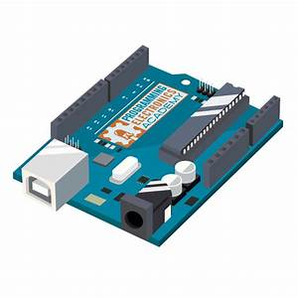
BANGABANDHU SHEIKH MUJIBUR RAHMAN DIGITAL UNIVERSITY, BANGLADESH
শিক্ষা নিয়ে গড়বো দেশ তথ্য-প্রযুক্তির বাংলাদেশ
PRESENTATION
COURSE CODE-IRE 105
COURSE TITLE-ELECTRONICS DEVICES AND APPLICATIONS SESSIONAL
PRESENTATION TITLE-SMART CLAP SWITCH
PREPARED BY:
GROUP-05
MEHRIN FARZANA(ID-21010013)
MARIA JAHAN MIM(ID-21010022)
ISMOT ARA(ID-21010027)
SADIA ISLAM MOU(ID-21010028)
INSTRUCTED BY:
SADIA ENAM
LECTURER
DEPARTMENT OF IRE, BDU

Slide 2

PROJECT TITLE- SMART CLAP SWITCH
1

Slide 3
Table of Contents
2
Objectives | Create a zero-touch device; a sound activated switch.
Difference/upgradation/Comparison with the recent works | Removes traditional switches and introduces a new way to turn devices ON or OFF.
Working Progress | The skeletal project is all ready, not suitable in consumer level yet.
Gantt Chart | Tracks design, fabrication, programming, and testing phases for timely completion.

Slide 4
Objectives
3
Create a zero-touch device; a sound activated switch.

Slide 5
Objectives
4
Design and construct a sound activated switch.
Implement it with Arduino UNO, LED and microphone.
Program the Arduino UNO.
Integrate the materials to turn the LED ON and OFF at the sound of hand clap.
Ensure safety features to prevent collisions or damage during operation

Slide 6
Difference/upgradation/Comparison with the recent works
5
Removes traditional switches and introduces a new way to turn devices ON or OFF.

Slide 7
Difference/Upgradation/Comparison with the recent works
6
Bring an alternative to the traditional switches when in darkness one finds it hard to find the switches.
Introduces zero touch switches.
Improved user interaction and control options, setting it apart from conventional designs.
Upgraded functionality and utility compared to standard switches, offering advanced manipulation abilities.

Slide 8
Working Progress
7
The skeletal project is all ready, not suitable in consumer level yet.

Slide 9
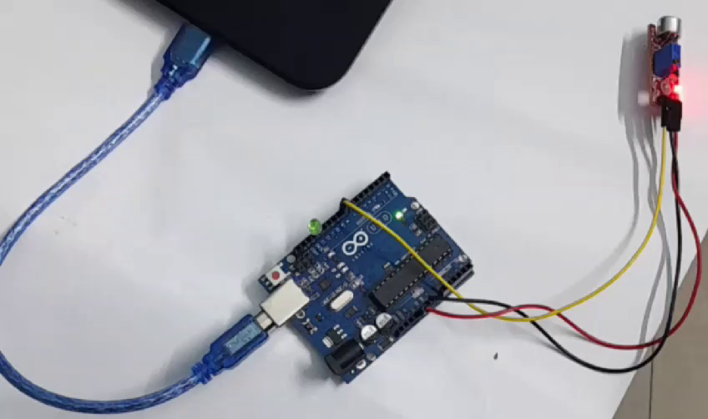
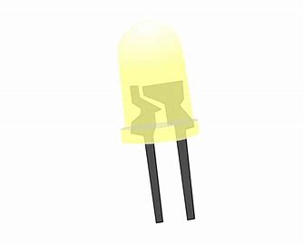
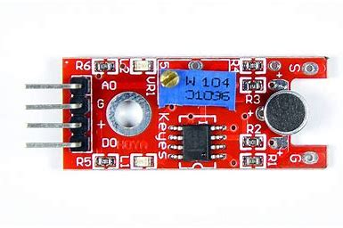
Working Progress
8
Programming Arduino(Completed): Developed code for Arduino microcontroller
to control other devices.
Attaching an output device (Completed): Successfully integrated an LED to show output as the switch turns ON or OFF.
Integating the microphone (Completed):
Integrating the microphone and adjusting the
frequency to succesfully detect clap sound.
LED
microphone
Ardiono UNO

Slide 10
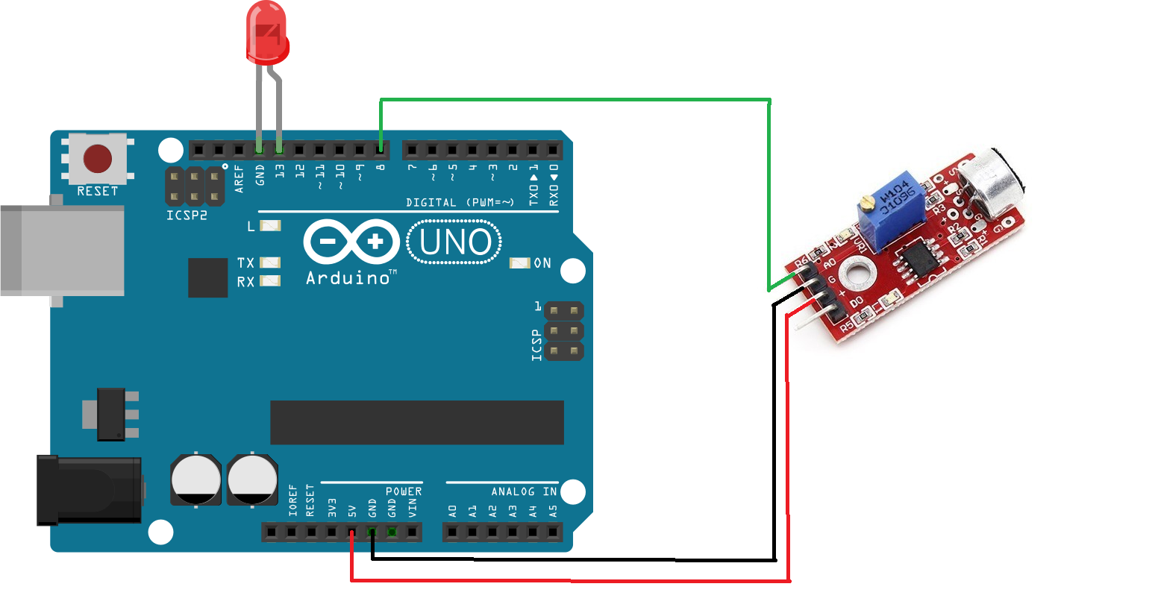
9
Assemble

Slide 11
1
0
void loop() {
int status_sensor = digitalRead(Sensor);
if (status_sensor == 0)
{
if (clap == 0)
{
detection_range_start = detection_range = millis();
clap++;
}
else if (clap > 0 && millis()-detection_range >= 50)
{
detection_range = millis();
clap++;
}
}
Arduino code
#define Sensor 8
#define RELAY_PIN 13
int clap = 0;
long detection_range_start = 0;
long detection_range = 0;
boolean status_lights = false;
void setup() {
pinMode(Sensor, INPUT);
pinMode(13,OUTPUT);
pinMode(RELAY_PIN, OUTPUT);
digitalWrite(RELAY_PIN, HIGH);
}

Slide 12
1
1
Arduino code
else if (status_lights)
{
status_lights = false;
digitalWrite(13, LOW);
digitalWrite(RELAY_PIN, HIGH);
}
}
clap = 0;
}
}
if (millis()-detection_range_start >= 400)
{
if (clap == 1)
{
if (!status_lights)
{
status_lights = true;
digitalWrite(13, HIGH);
digitalWrite(RELAY_PIN, LOW);
}

Slide 13
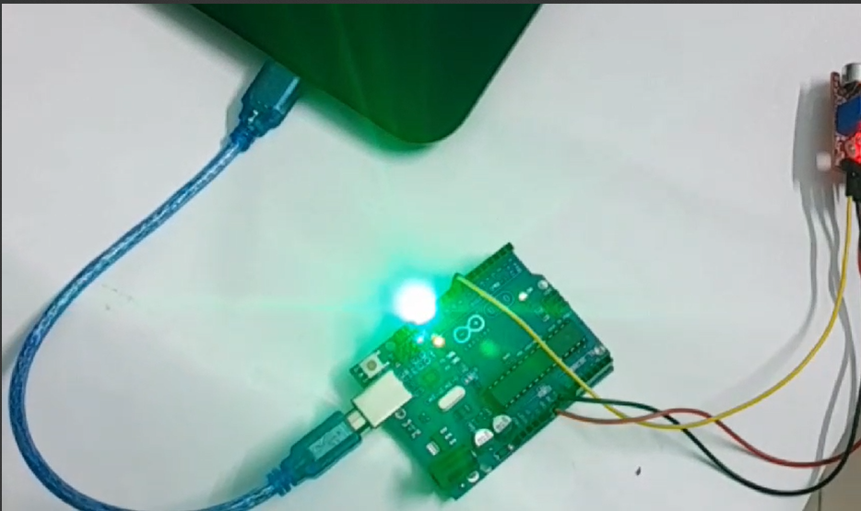
In Progress
1
2
Optimization and Debugging (Partial):
Fine-tuning the system for optimal performance and troubleshooting any issues.

Slide 14
Working Progress
1
3
100%
Materials Assembly
Done
Materials Integration
100%
Done
Arduino Programming
100%
Done
Integration and Calibration
100%
Done
System Integration
100%
Done
Optimization and Debugging
50%
Partial

Slide 15
Gantt Chart
1
4
Tracks design, fabrication, programming, and testing phases for timely completion.

Slide 16
Gantt Chart
1
5
Task | Start Date | End Date | Duration | Progress
Materials Assembly | 2/10/2024 | 2/10/2024 | 1 | Done
Materials Integration | 2/10/2024 | 2/10/2024 | 1 | Done
Arduino Programming | 3/24/2024 | 3/24/2024 | 1 | Done
Integration and Calibration | 2/10/2024 | 2/10/2024 | 1 | Done
System Integration | 2/10/2024 | 2/10/2024 | 1 | Done
Optimization and Debugging | 3/26/2024 | 5/12/2024 | 1 | Partial

Slide 17
Thanks!

